Slide 1
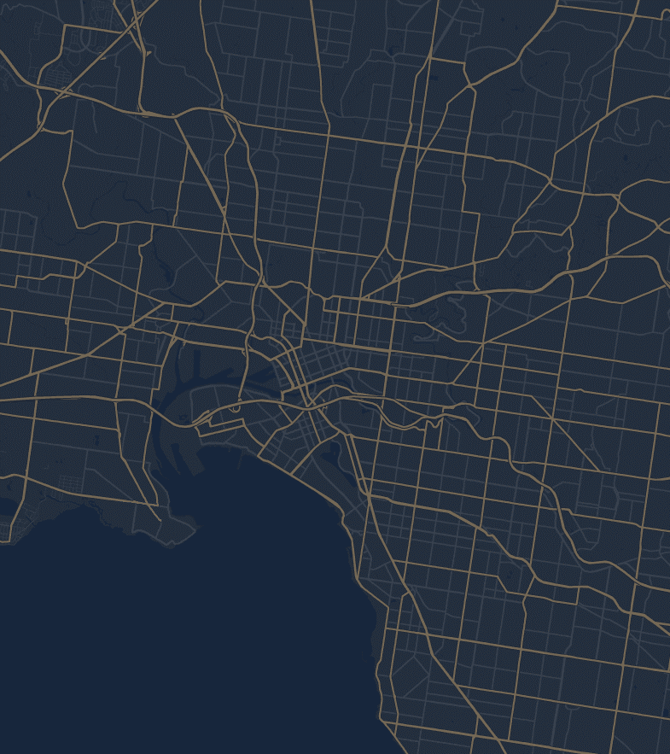

Predicting Rental Price
MAST30034 Industry Project
Group 50

Slide 2
Our Team:
Anh Phi Vu
Chanh Thanh Tang
Connor Liu
Ngoc Nhu Quynh Ho
Duc Hoan Nguyen

Slide 3

Project Objectives

Slide 4
Objectives
1
Identify key internal and external features that influence rental price
2
Identify the top 10 regions with the highest predicted growth rates
3
Determine the most liveable and affordable region

Slide 5

Objective 1
Identify key internal and external features that influence rental price
We define:
Internal: related to the property itself
External: related to the region and the location of the property

Slide 6

Objective 2
Identify the top 10 regions with the highest predicted growth rates
Growth rate is categorised into price, population density, income and crime density
Our metric used is the Composite Growth Index (CGI), the linear combination of each category with assigned weights

Slide 7




Objective 3
Determine the most liveable and affordable region
Our definitions:
Affordability: The portion of income spent on rent
Livability: The combination of affordability, CGI and the density of groceries shop, shopping centers, police stations, hospital and public transport

Slide 8



Project Logistics
Meetings:
Weekly during tutorial time
Communication:
Via Facebook Messenger
Management:
Done through Notion

Slide 9
Dataset

Slide 10

Property
Dataset
Scraped from popular Real Estate website domain.com.au
Data from a total of 9,539 rental properties across Victoria were scraped

Slide 11



External
Datasets
Australian Bureau of Statistics:
Population and Income across Victoria
Victoria State Government Department of Families, Fairness, and Housing:
Victorian School Locations
Crime Statistics Agency:
Crime offence records across Victoria

Slide 12

Spatial
Data
Application Program Interface (API)
An API is an intermediary that provides a way to extract and share data across applications
In our project, we used Google Maps Platform to obtain our spatial data

Slide 13
Spatial
Data
Application Program Interface (API)
First, we found locations of facilities and services across Victoria, such as police stations, hospitals, train stations, supermarkets,…
Then the distance and travel time from each property to the nearest location of each facility was calculated

Slide 14



Security
API keys are stored securely and used offline to obtain spatial data.
Library implementation used to monitor the usage of API keys.
This was done to stop malicious activity and prevent accidental billing

Slide 15
Pre-processing

Slide 16

Missing Data
Unnecessary columns and columns with a high amount of missing value were dropped from the datasets
For columns with low missing value counts, many different methods were used to impute the missing values, such as Linear Regression, impute using mean, or using a set growth rate

Slide 17

Feature
Engineering
Only data from 2015 onward was included to maintain relevancy
Rent prices were often inconsistently formatted, all were converted to price per week
Added new indicator variable of whether the property was furnished or not

Slide 18
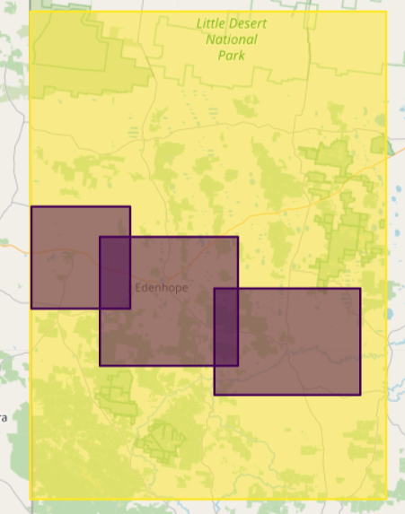
Suburbs to
SA2 District
West Wimmera
Apsley
Edenhope
Although the ABS provides a shapefile for the SA2 district borders, we were unable to find a shapefile for Victorian suburb borders
To solve this, we used an API to obtain the bounding box for each suburb and then were able to identify their respective SA2 districts
Harrow

Slide 19
Data Distributions

Slide 20
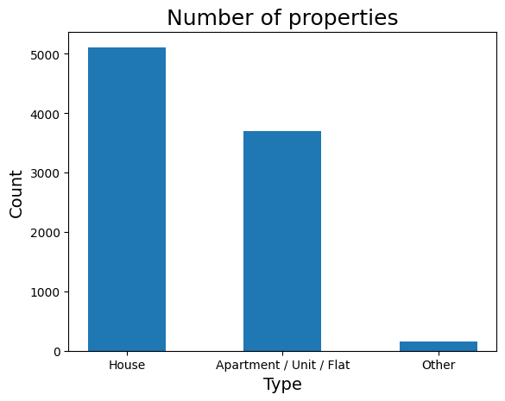
Property Data – Property Type

Slide 21
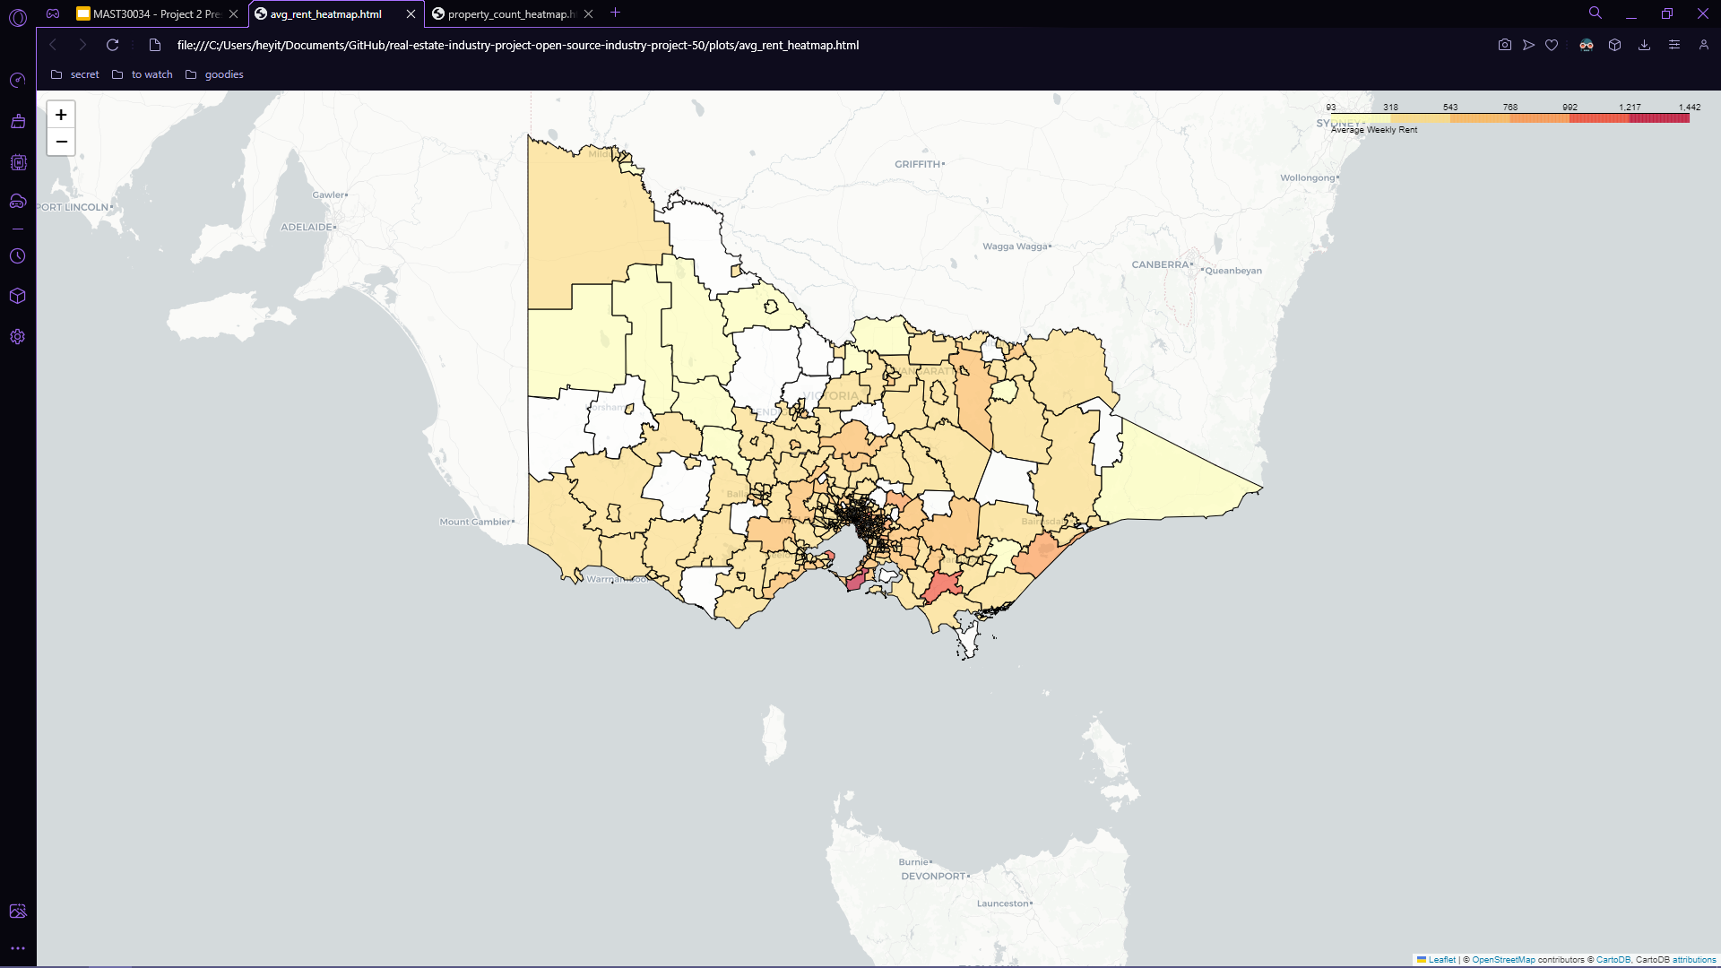
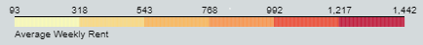
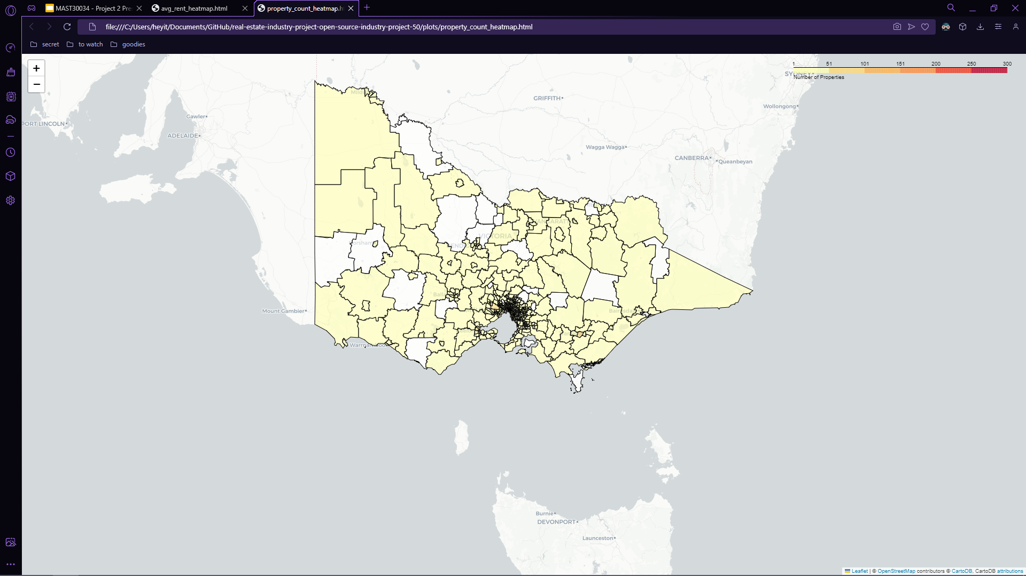
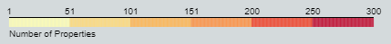
Property Data
-
Rental Price & Distribution
Average Weekly Rent
Property Count

Slide 22
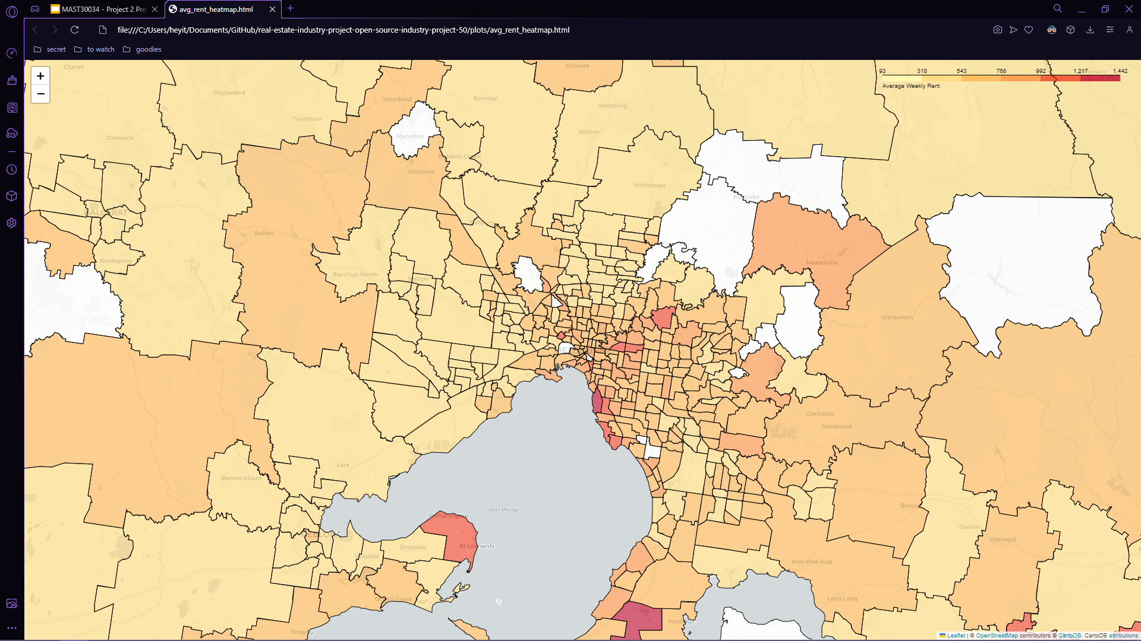
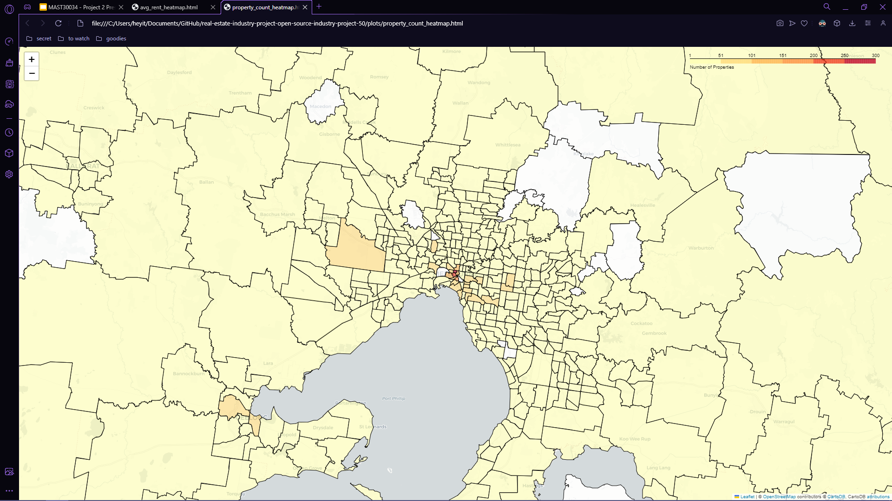
Property Data
-
Rental Price & Distribution
Average Weekly Rent
Property Count

Slide 23
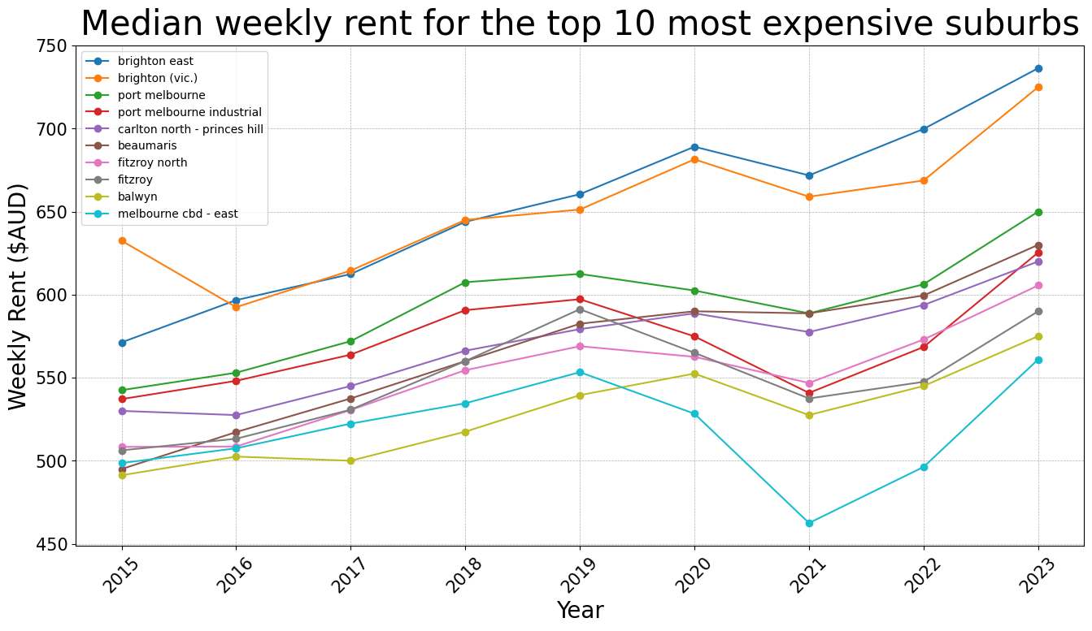
External Data – Rental Price

Slide 24
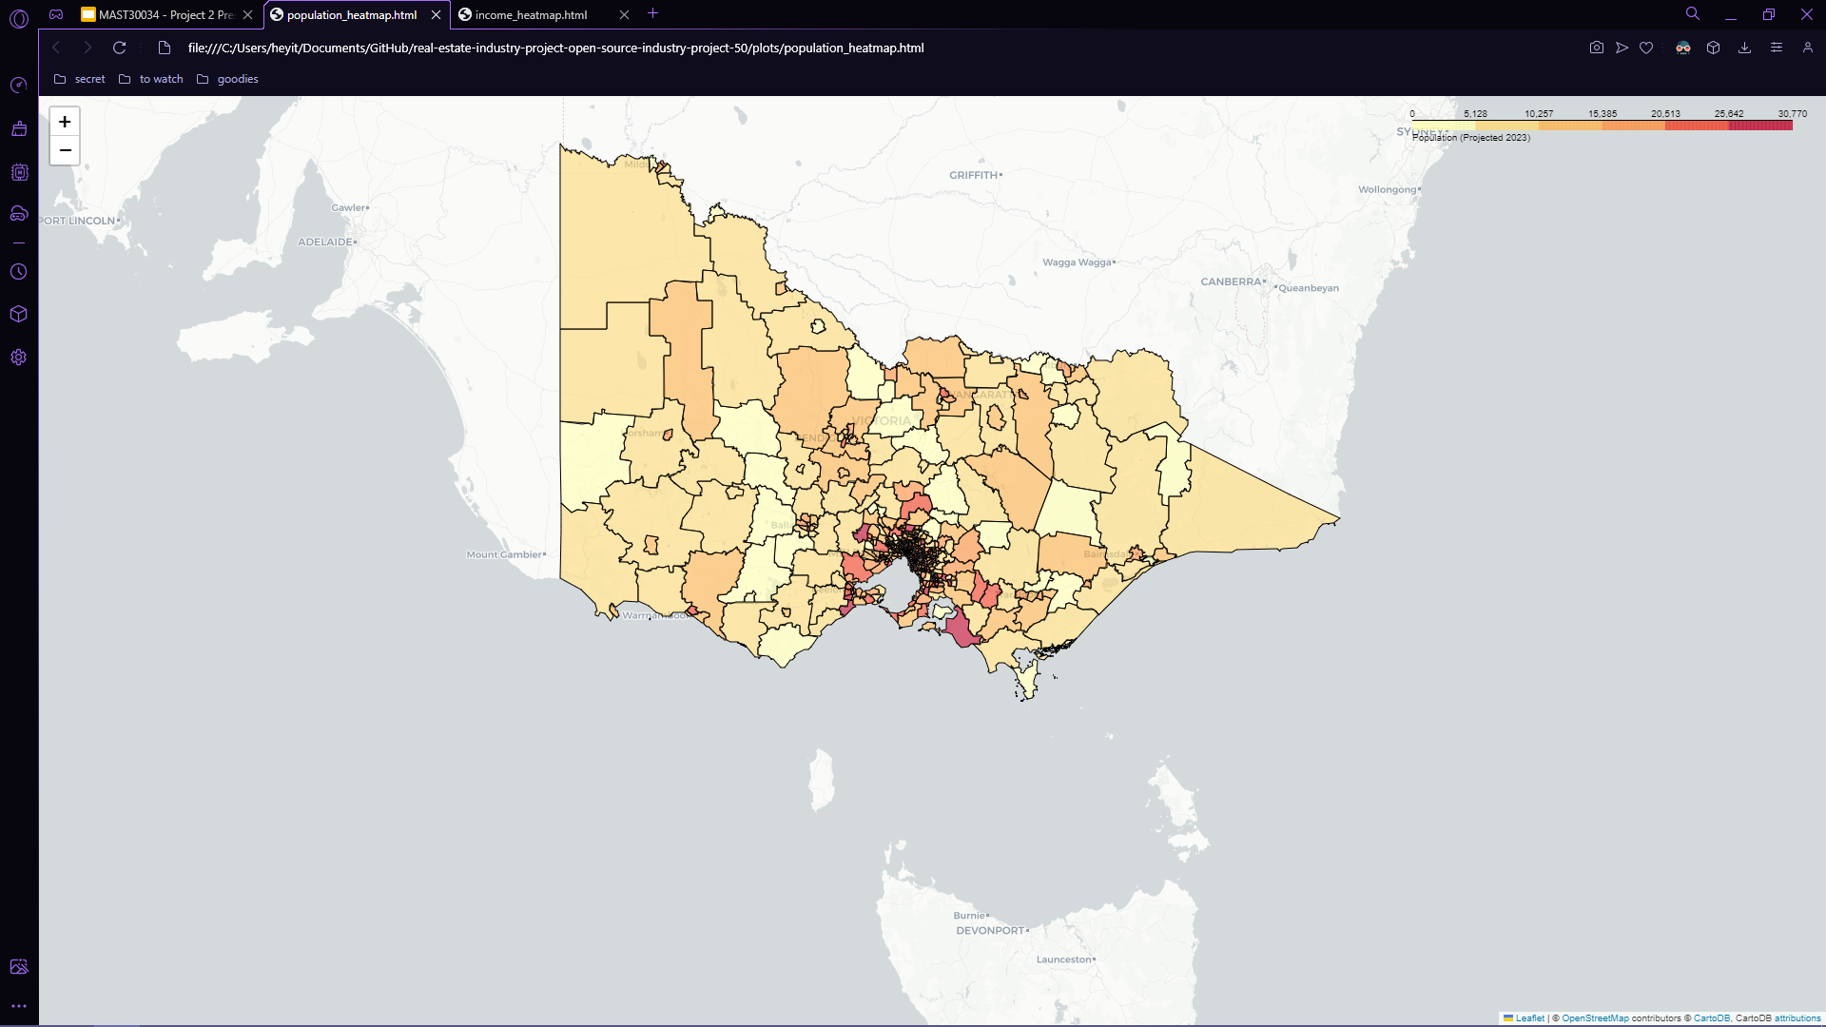
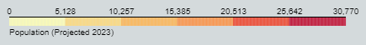
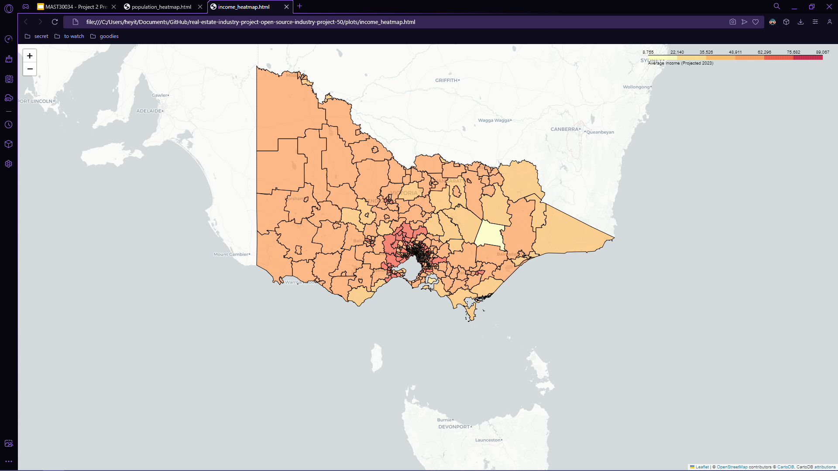
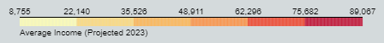
External Data
-
Population
&
Income
Region Population
Annual Income

Slide 25
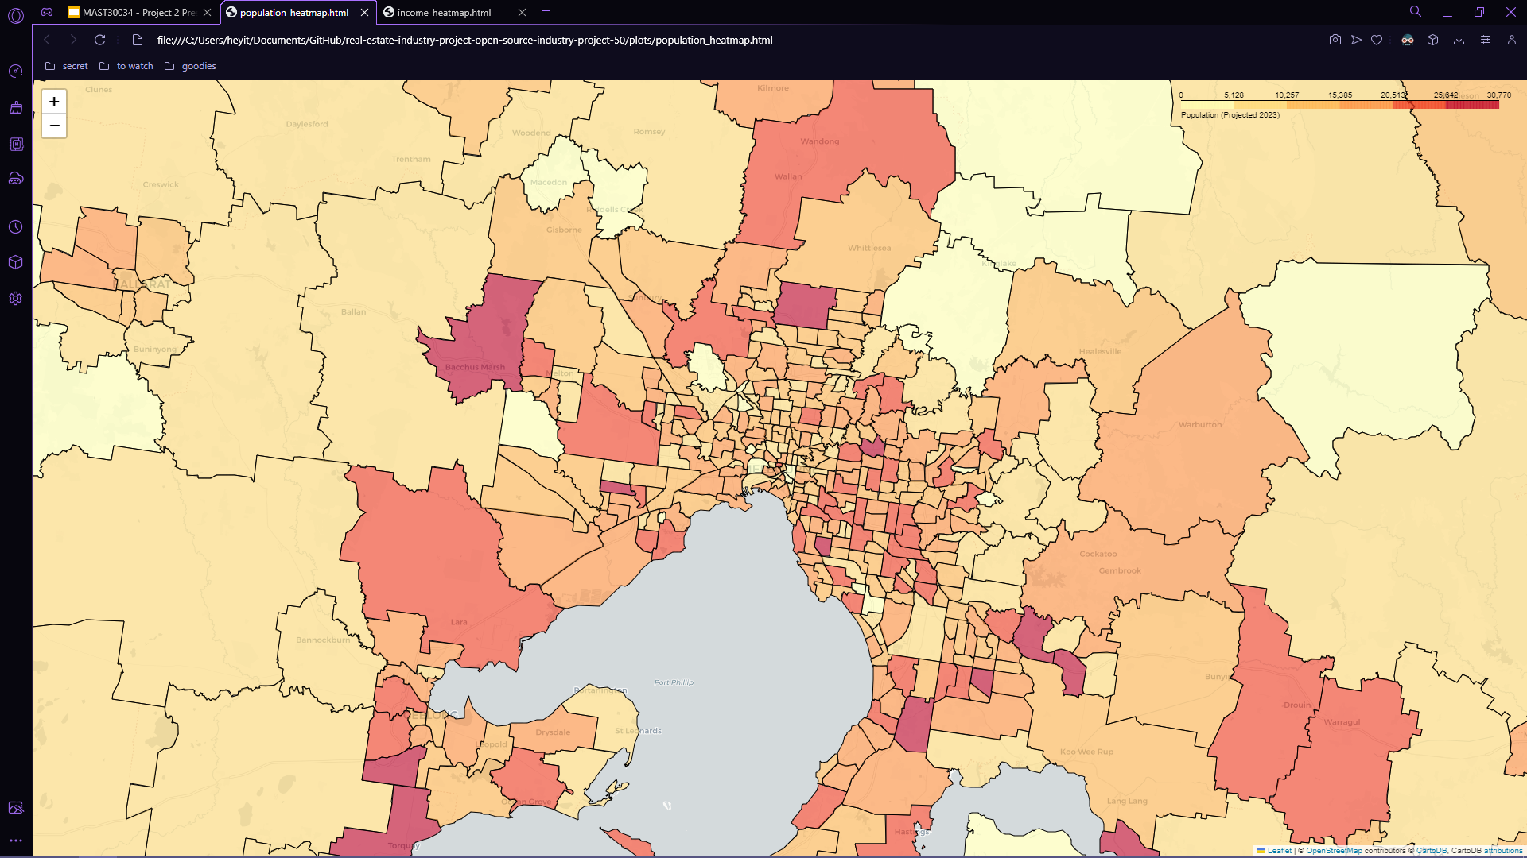
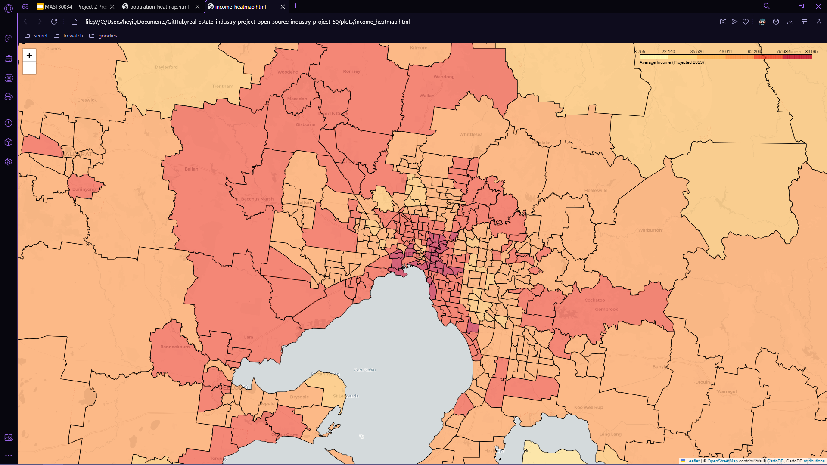
External Data
-
Population
&
Income
Region Population
Annual Income

Slide 26
Model

Slide 27
Model Introduction
Random
Forest:
Used to predict the rental price for a specific property
Hierarchal Clustering:
Classifies groups of SA2 districts
Linear Regression:
Uses SA2 data and group labels to create future predictions

Slide 28

Objective 1
Identify key internal and external features that influence rental price
In its predictions, our model was within 8% of the actual weekly rent price of a given property most of the time
Furthermore, we extracted the features from the model which were most impactful towards its predictions, as these would be the best characteristics of the property

Slide 29




Objective 1
Identify key internal and external features that influence rental price
From our model, the best internal features were:
- Number of bathrooms
- Number of bedrooms
- Whether property is furnished
- Number of parking spaces
- Property Type (Apartment/House/Other)

Slide 30

Objective 1
Identify key internal and external features that influence rental price
From our model, the best external features were:
- The region’s overall average rental price, annual income, population and crime rate.
- Distances to the nearest police station, hospital, market, shopping center and CBD.

Slide 31
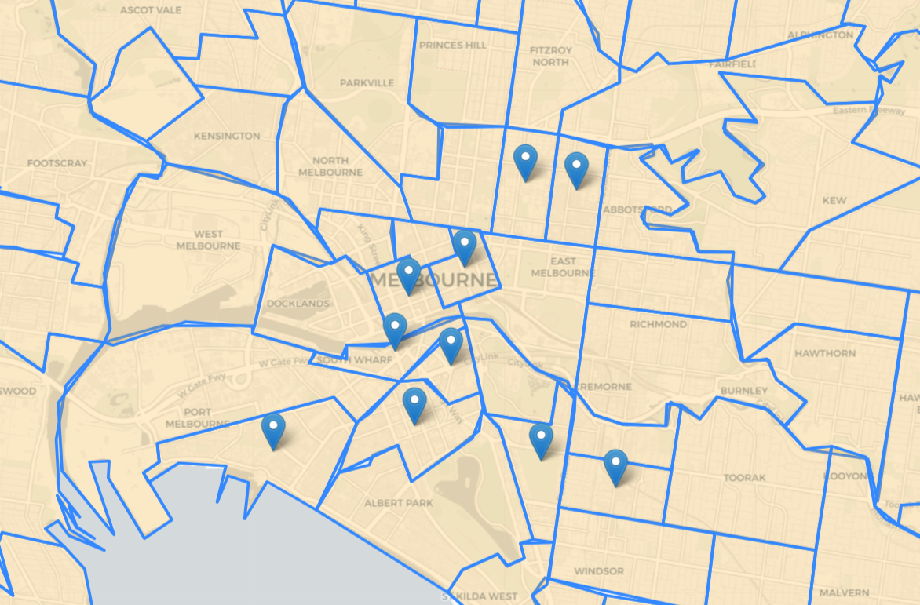
Objective 2
Identify the top 10 regions with the highest predicted growth rates
Fitzroy
Melbourne CBD - West
Collingwood
Using our CGI, the top 10 regions are:
Southbank - West
Melbourne CBD - East
Port Melbourne
South Yarra – South
Melbourne CBD – East
Fitzroy
Melbourne CBD - West
Southbank – East
Collingwood
South Yarra – West
South Melbourne
Southbank (West) – South Wharf
Southbank - East
Port Melbourne
South Yarra - South
South Melbourne
South Yarra - West
All high growth rate regions are in the inner metropolitan area and the CBD.

Slide 32
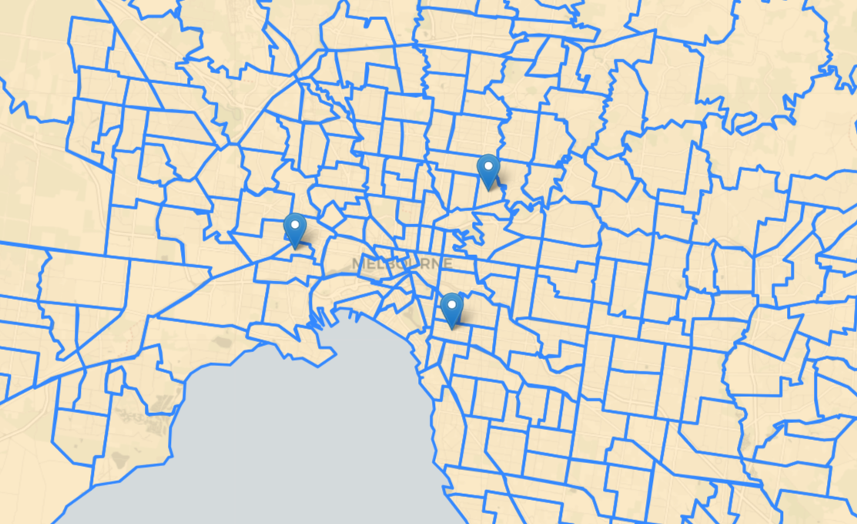
Objective 3
Determine the most liveable and affordable region
Alphington - Fairfield
Based on our definitions, top 3 regions by affordability are:
Seddon - Kingsville
Alphington – Fairfield
Prahan – Windsor
Seddon - Kingsville
Prahran - Windsor
By our metrics, the most affordable regions are in the outer metropolitan area.

Slide 33
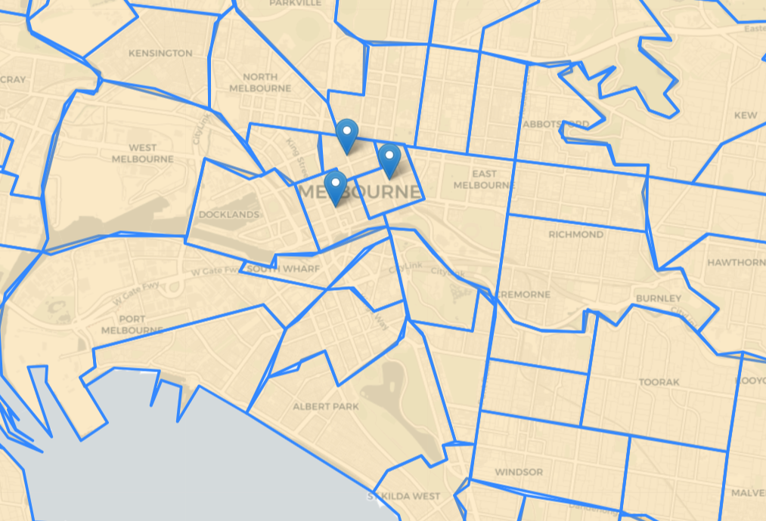
Objective 3
Determine the most liveable and affordable region
Melbourne CBD - North
Based on our definitions, top 3 regions by liveability are:
Melbourne CBD - East
Melbourne CBD - West
Melbourne CBD – North
Melbourne CBD – West
Melbourne CBD – East
By our metrics, the most liveable regions are in the Melbourne CBD.

Slide 34
Recommendations

Slide 35
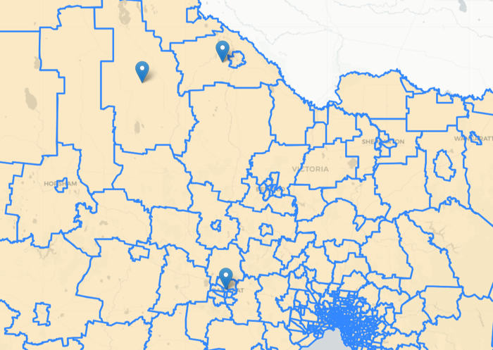
For Investors
Focus on investing on properties in regions where the rental price growth rate is high.
Top 3 regions by rental price growth:
Buloke, Gannawarra, Ballarat
Growth by 2026:
36.1%, 29.4%, 25.2%
Gannawarra
Buloke
Ballarat

Slide 36
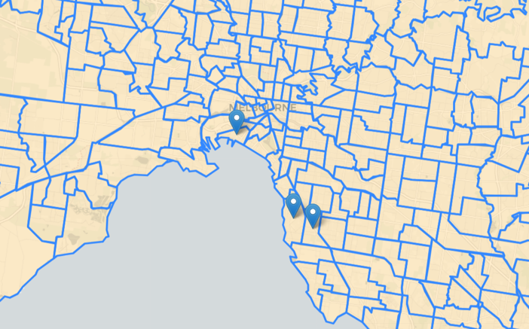
For Investors
Avoid investing on properties in regions where the rental price growth rate is low.
Bottom 3 regions by rental price growth
Port Melbourne, Brighton, Brighton – East
Growth by 2026:
-39.8%, -38.9%, -37.9%
Port Melbourne
Brighton - East
Brighton

Slide 37
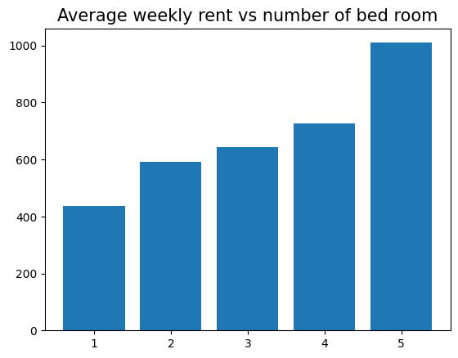
For Leasers
Average Cost to Furnished a property
1 bedroom | 1 kitchen | 1 living room
$300 AUD - $500 AUD | $100 AUD - $200 AUD | $400 AUD - $600 AUD
Large properties with many bedrooms don’t yield as much as multiple small properties with less bedrooms, therefore they should consider splitting a larger property into multiple smaller properties
Furnishing a property is very important for a higher rental price, with an average increase of $79 per week, it will only take around 6-8 months to break even on the investment of furnishing a property

Slide 38
For Long Term Renters
Melbourne CBD - North
Seek to rent in areas with high liveability, which often means that the living conditions and environment are good, and there will be good public amenities
Top 3 regions by Liveability:
Melbourne CBD – North
Melbourne CBD – West
Melbourne CBD – East
Melbourne CBD - East
Melbourne CBD - West

Slide 39
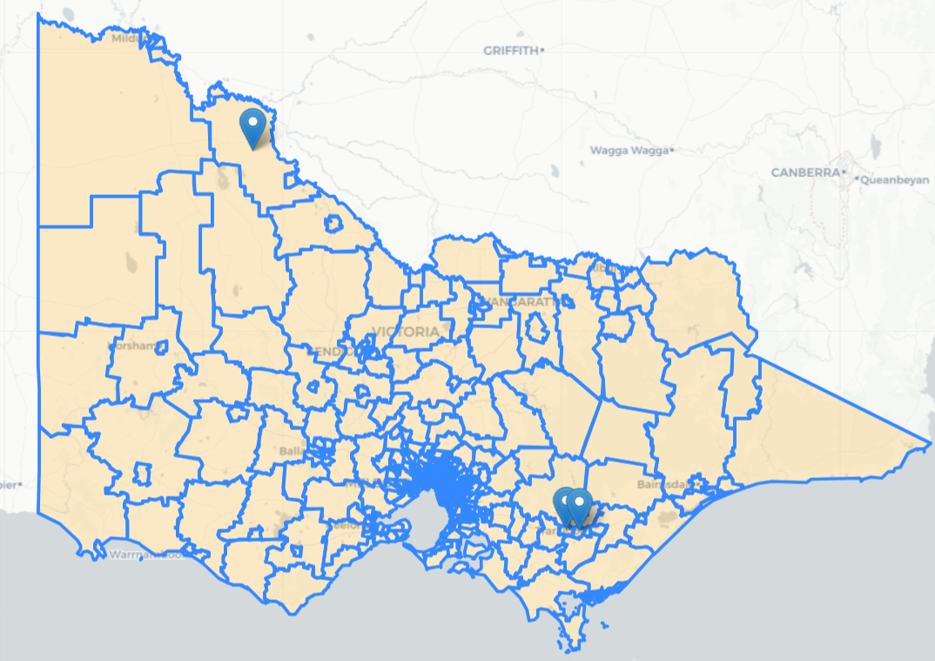
For Short Term Renters
Swan hill Surrounds
Seek for region where the rental price is low since the stay is temporary. It is also good focus on location, such as a student choosing an apartment near their university
Bottom 3 SA2 District by rental price:
Swan hill Surrounds, Morwell, Moe - Newborough
Morwell
Moe - Newborough

Slide 40

For Real Estate Companies
In listings, put emphasis on key features
Focus on advertising the properties in the regions with high growth rates
Ensure property portfolio is diverse across different price points, this allows the company to cater towards a wider audience

Slide 41
References:
Logos:
https://www.messenger.com
https://www.notion.so
https://www.domain.com.au
https://www.abs.gov.au/statistics
https://www.dffh.vic.gov.au
https://www.crimestatistics.vic.gov.au
https://mapsplatform.google.com

